Slide 1
Bckpck
An excursion into the contents
Of a wandering man’s backpack

Slide 2

… or put another way …

Slide 3
Going places
Step 1: Backpack and Kit
Step 2: Adapters
Step 3: PROFIT (or Physical Security)
Step 4: Data Things
Step 5: Wireless Things
Step 6: Hardware Things
Step 7: Entertainment
Step 8: Trading Faces

Slide 4
Backpack
& Kit
How are you going to store it?

Slide 5
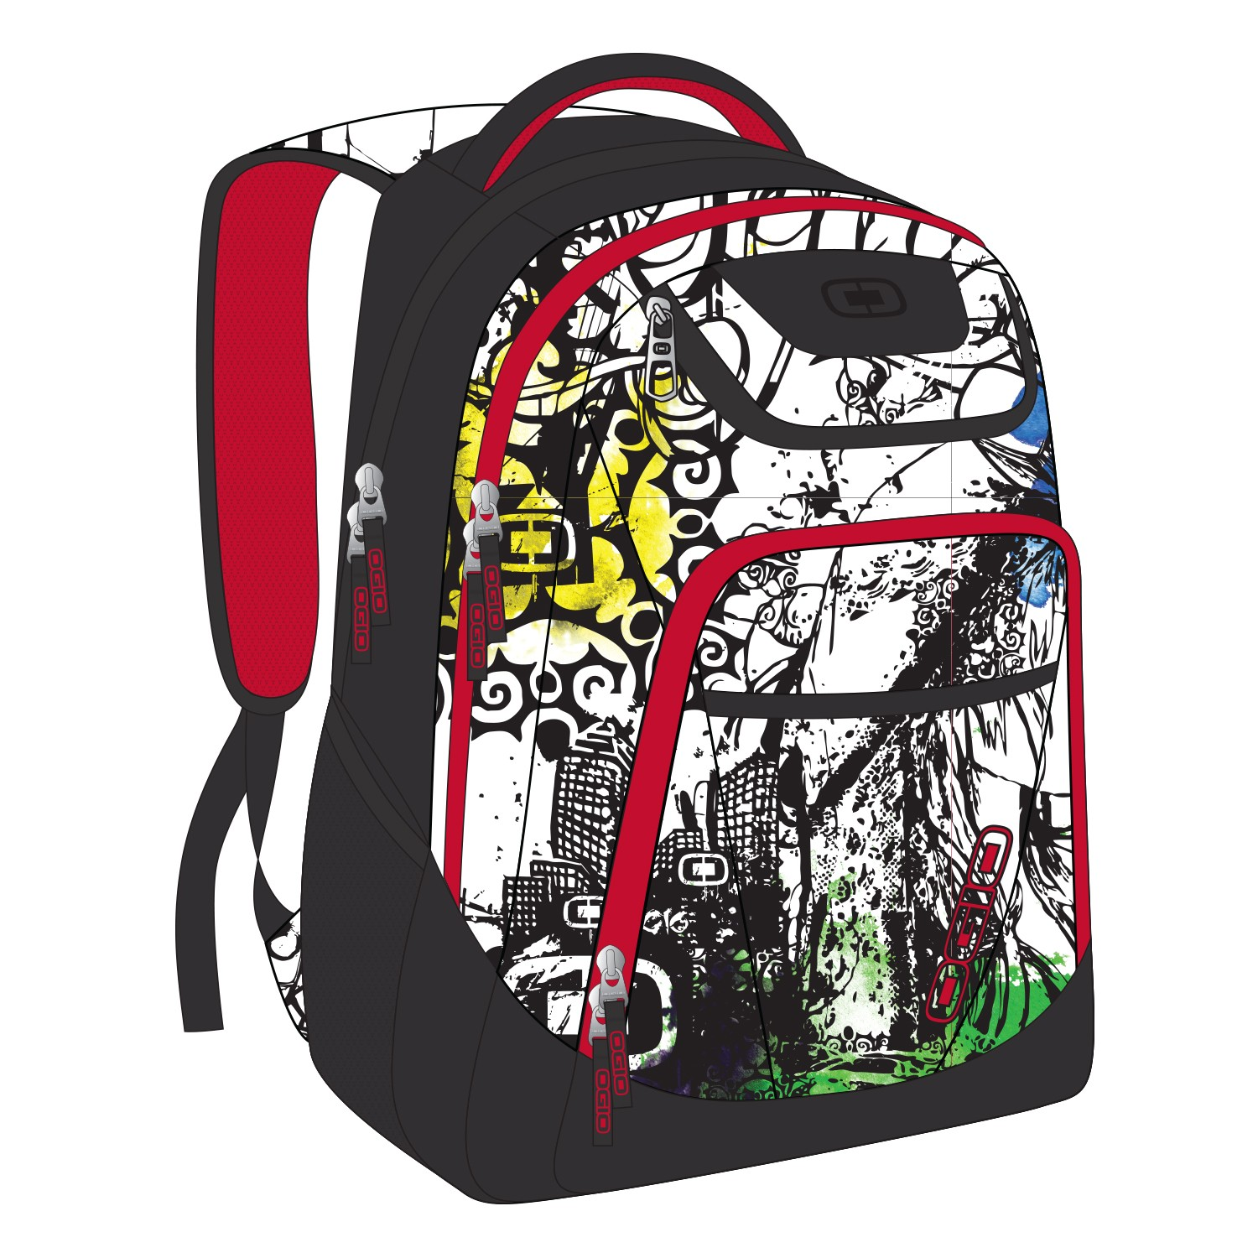

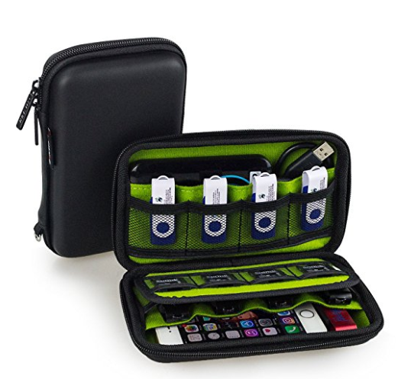
Backpack & Kit
Backpack: OGIO Tribune Graffiti
USB Drives: Estarer YPB02SCU
Other gear: Infinite Storage System Flambeau T900

Slide 6
Adapters
Helping things talk like friends

Slide 7

Adapters
HDMI (f) → DVI (m)
RGB (f) → DVI (m)
DPORT (m) → RGB (f)
MicroSD (f) → SD Card (m)
USB type C (m) → 3.5mm audio (m)
USB type C (m) → USB type A (f)
USB type C (m) → USB type A (f) OTG Cable
USB type A (m) → USB type C/Lightning (m)
10 color hand to writing (pen)
Various power adapters
SIM Card (f) → USB type A (m)
Sabrent HB-UM43 USB 3.0 hub

Slide 8
Physical security
Know thine environment

Slide 9
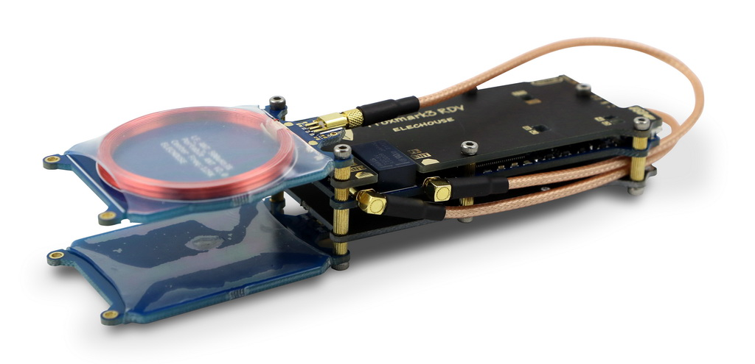


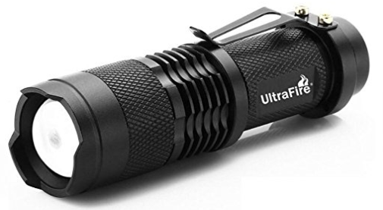
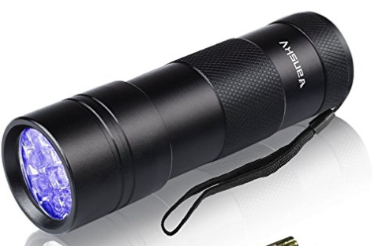
Physical security
Proxmark RDV2 RFID read/write
Tactical Flashlight
Blacklight Flashlight
Utilikey
Sparrow Tuxedo Lockpicks
Metal shim
Multi-function knife
Screwdriver set

Slide 10
Data Things
It’s not just usb anymore
(but it mostly is)

Slide 11
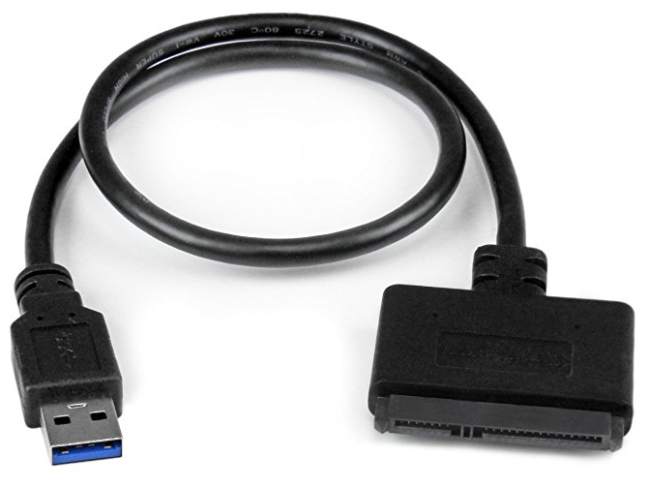
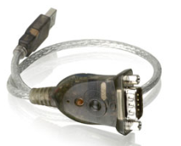
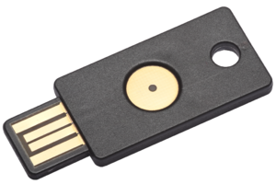
Data things
StarTech USB352SAT3CB SATA USB 3 type A (m) cable
IOGEAR GUC232A USB 2 (m) to Serial DB-9 (m) cable
2x Yubico (one for external sites, one for local encryption)
External USB drive (2 TB, milspec drop rating)
USB drives for:
  TAILS
  Windows (every server/desktop version from 3.1 through 10/NT3.51 through 2016)
  Kali Linux (multiple variants, including Benedict Slade)
  vmWare remote console
  pfSense

Slide 12
Communication things
We all need to hear and be heard

Slide 13
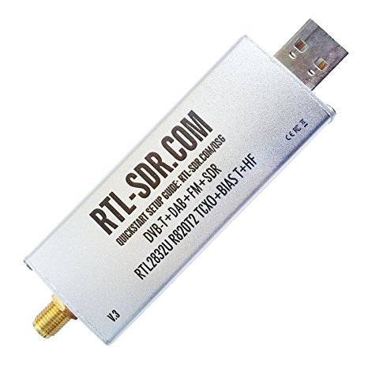
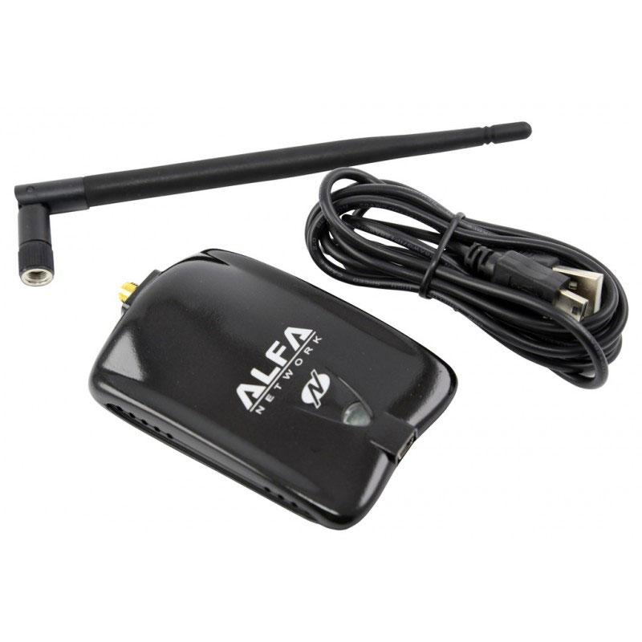
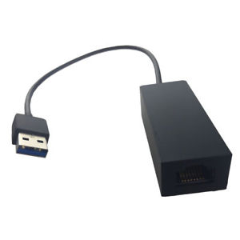
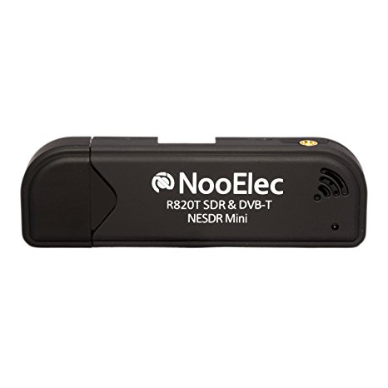
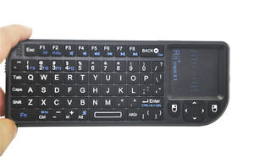
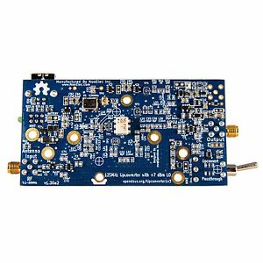
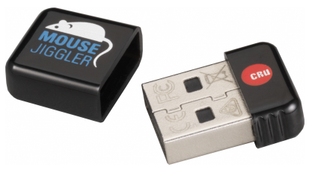
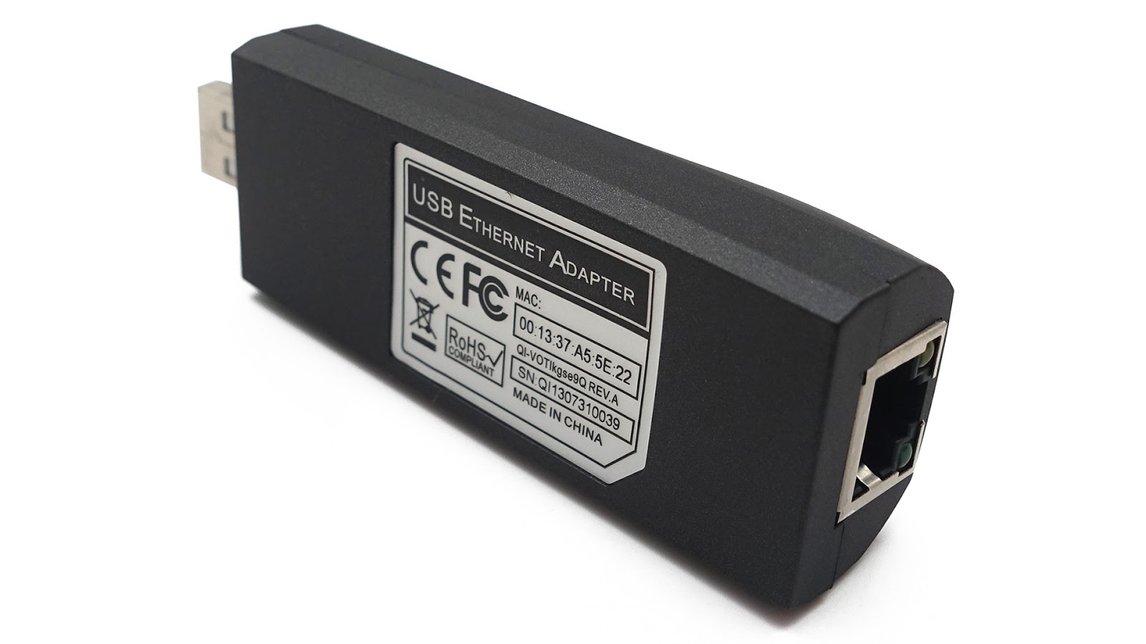
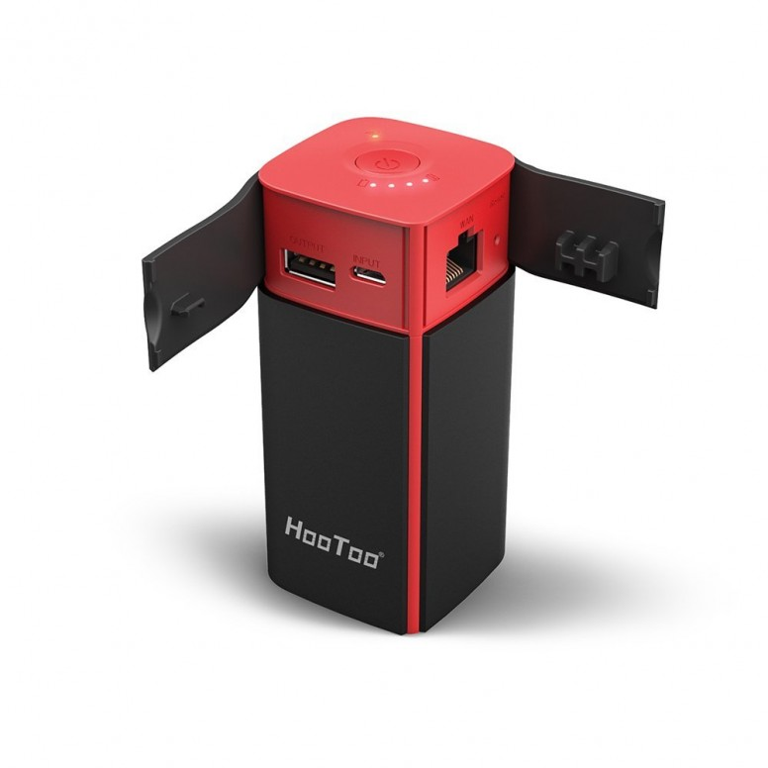

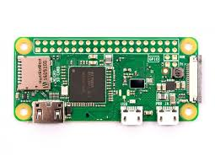
Communication Things
Alfa Networks AWUS036NHA 802.11 b/g/n Adapter
Ralink USB WiFi RT5370
Microsoft 1663 USB Gigabit Ethernet Adapter
KY-QF9700 100 MB Ethernet Adapter
Rii Mini x1 Wireless Micro Keyboard/Touchpad
CRU MJ-3 Mouse Jiggler
AWS IOT Dash Button
RTL-SDR Blog R820T2 RTL2832U SMA SDR
NooElec RTL-SDR R820T RTL2832U
HamItUp RF +7 dBm Upconverter
Hak5 LAN Turtle
HooToo HT-TM05 Wireless N Travel Router/Bridge/10400 mAh Battery
3x Raspberry Pi Zero W (PoisonTaps)
Plugable USB-BT4LE Bluetooth 4 LE adapter
Spare Google Fi and Ting Wireless SIM cards

Slide 14
Hardware hacking things
Talking to software hidden inside hardware

Slide 15
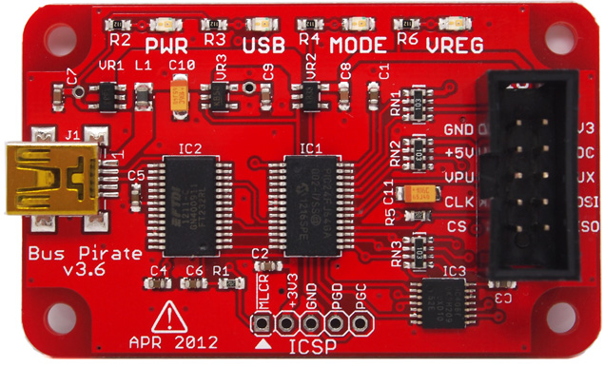
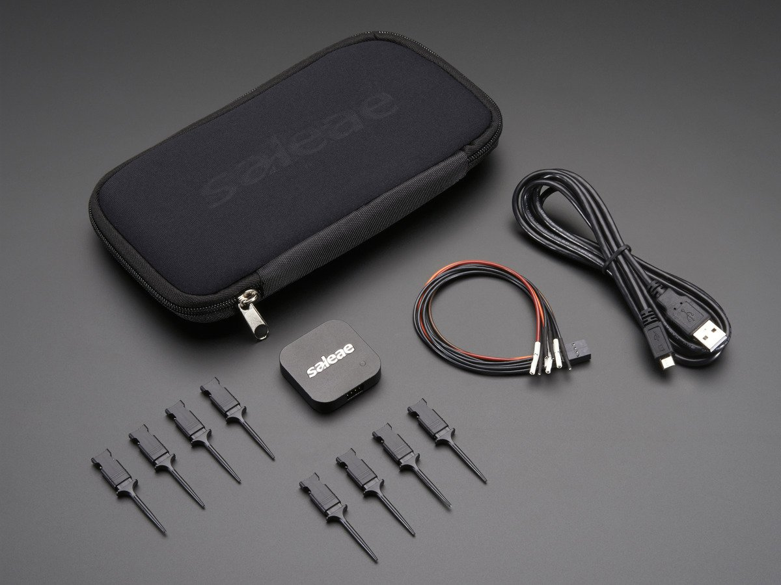
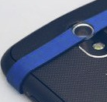
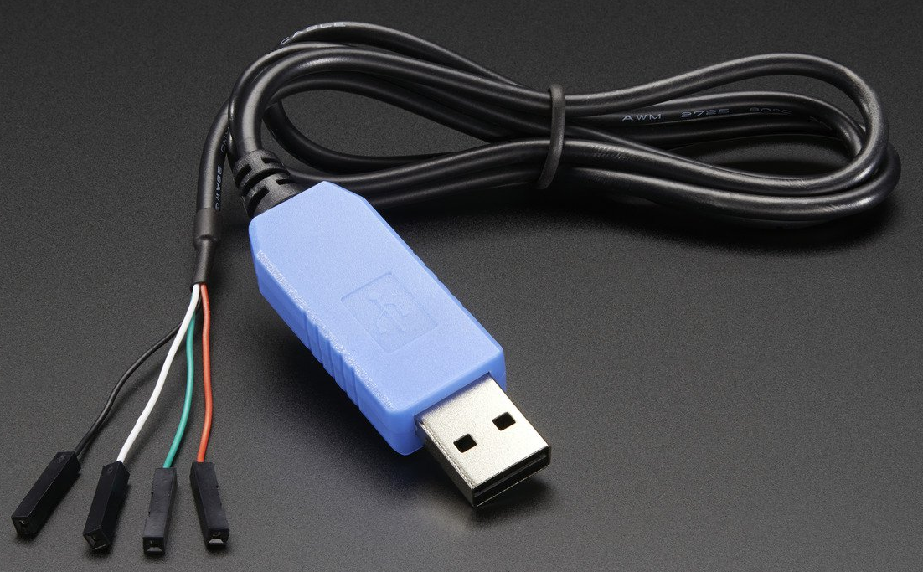

Hardware hacking things
Phone magnifying lens
USB to TTL Serial Cable
Salae Logic 4 (4 Channel Logic Analyzer)
Grand Idea Studio JTAGulator
Sparkfun/Dangerous Prototypes BusPirate
Various alligator clips

Slide 16
entertainment
Stakeouts can get boring

Slide 17
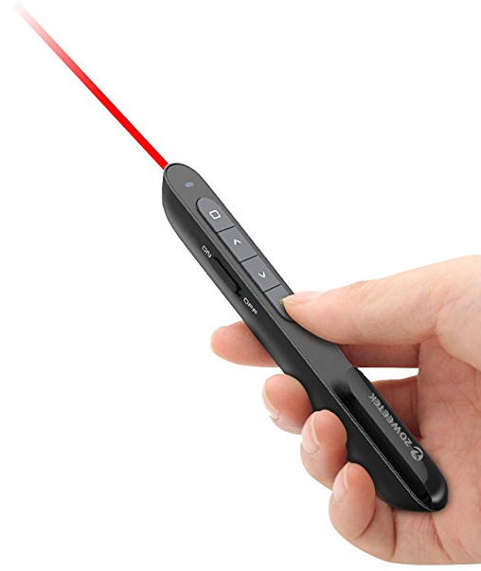
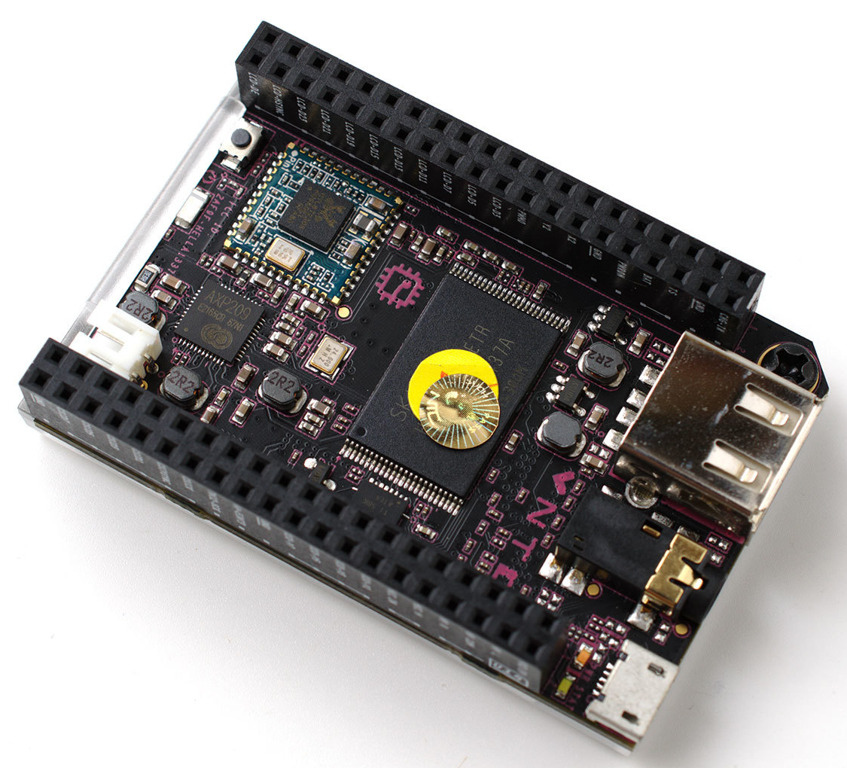
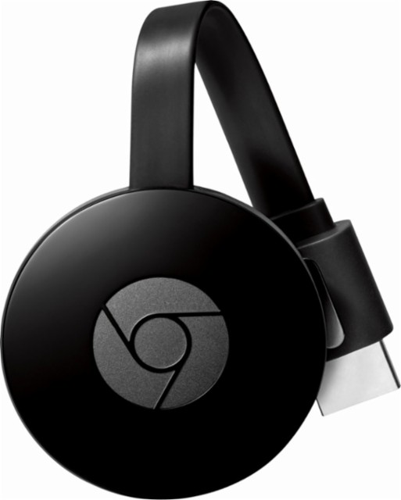


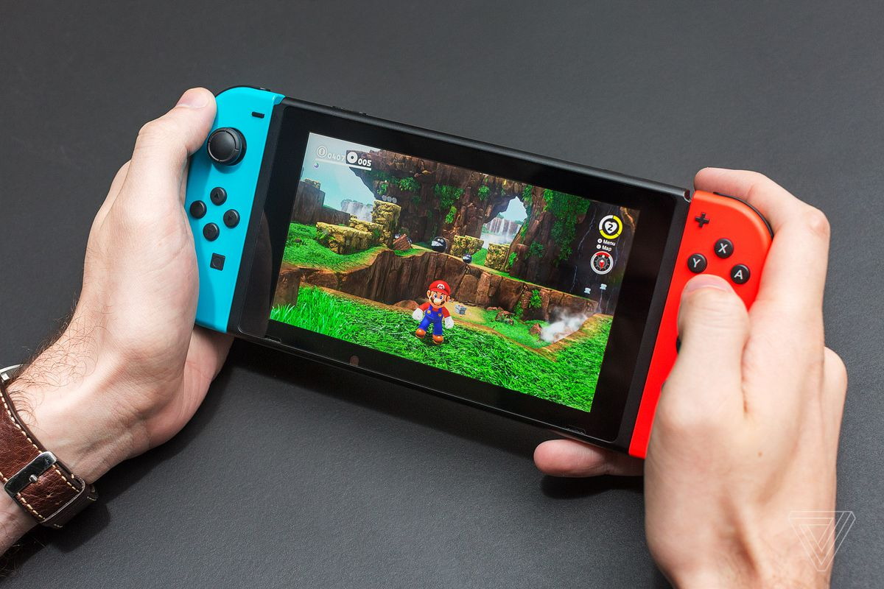


entertainment
Google Chromecast
Nintendo Switch
NextThingCo C.H.I.P.
Amazon Kindle Paperwhite (6” WiFi)
Universal kickstand
Slide presenter/laser pointer
D10 and D12 (for much random)

Slide 18
Trading faces
…Or stickers
…Or identities

Slide 19
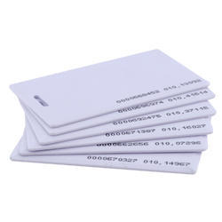

Trading faces
Blank RFID chips/badges
Hermit stickers
Conference business cards
Brian Mork
CISO
Celanese
]-[ermit
(math problem to find phone number)
(sed approach to find email)

Slide 20
Thank you!
If [questions.length() != 0]; then
for each q in questions[] send a;
End if

